Slide 1


Foundations of
Scientific Computing
Dave Biersach
dbiersach@bnl.gov
Task 04
Estimating
Infinite Series

Slide 2
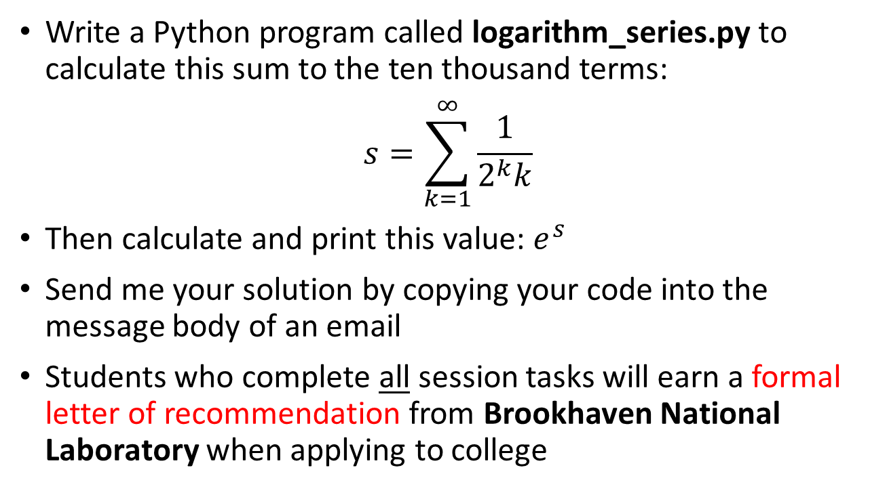
Task 04
Write a Python program called logarithm_series.py to calculate this sum to the ten thousand terms:
$$s=\sum_{k=1}^{∞}{\frac{1}{2^{k}k}}$$
Then calculate and print this value: $e^{s}$
Send me your solution by copying your code into the message body of an email
Students who complete all session tasks will earn a formal letter of recommendation from Brookhaven National Laboratory when applying to college

Slide 3
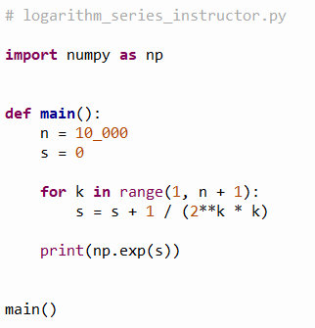
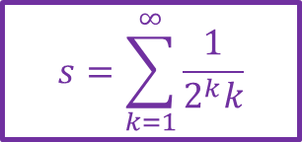

Open logarithm_series_instructor.py
①
②
③
$$s=\sum_{k=1}^{∞}{\frac{1}{2^{k}k}}$$
$$\frac{1}{0}$$
④
$$e^{s}$$
⑤
⑥

Slide 4
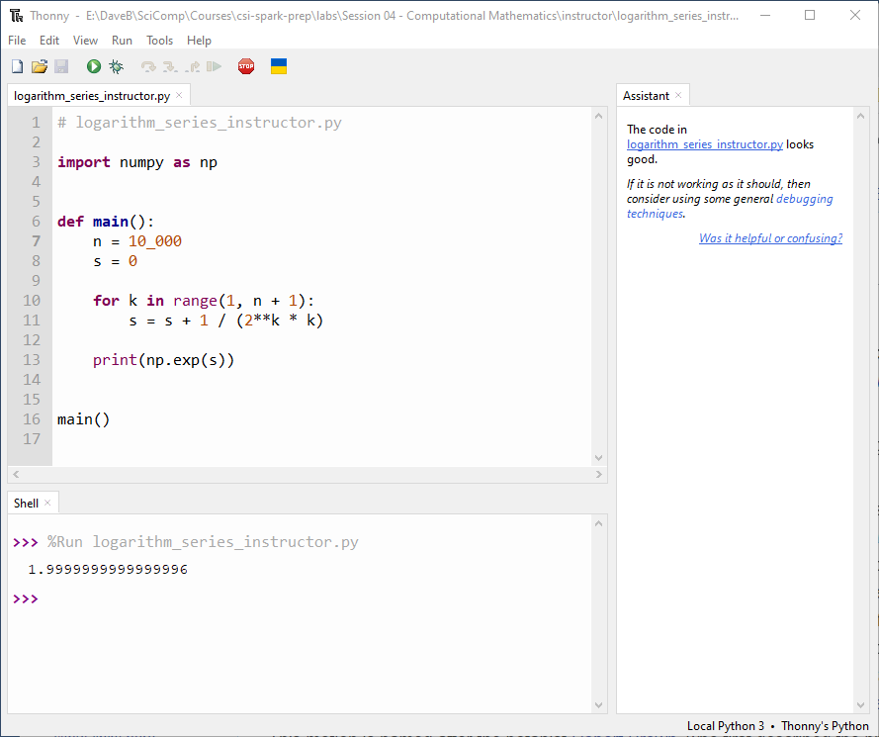
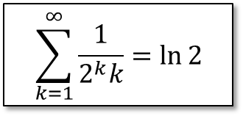
Run logarithm_series_instructor.py
$$\sum_{k=1}^{∞}{\frac{1}{2^{k}k}}=\ln{2}$$

Slide 5
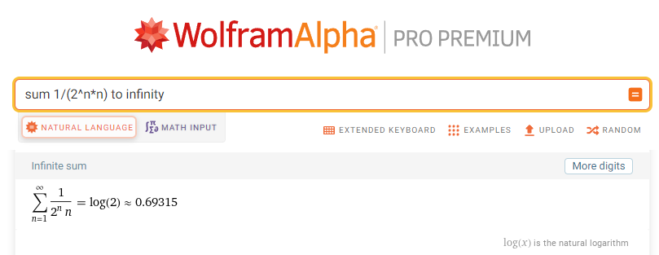

Run logarithm_series_instructor.py
$$e^{\ln{2}}=2$$
$$\sum_{k=1}^{∞}{\frac{1}{2^{k}k}}=\ln{2}$$

